Slide 1
Completing Beyond the Available Data

Slide 2
Completing Beyond the Available Data
Dataset 1
Not measured
Can we predict the
unmeasured values?
Not measured
Dataset 2

Slide 3



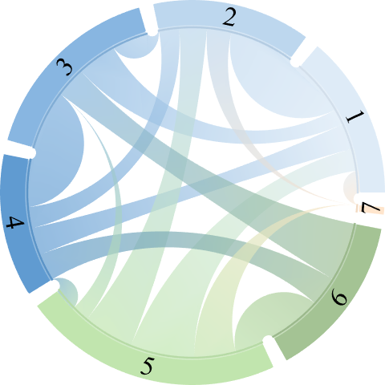

Leave-One-Out
Transferability
Study 1
Study 5
Study 2
Study 6
Study 3
Study 4
Study 7
Notes:
This type of cross-study prediction is under-explored, and it opens up many exciting avenues of research such as:
How similar are the trends in human infection vs human vaccination data.
How similar are the ferret and human responses, and what lessons can we take from ferrets and port into humans?
Which studies have the most transferable information
I’ll point out that comparing these datasets really exemplifies a physicist’s mindset. The literature often makes you feel like every person is special, with their unique infection history and antibody repertoire, and that every study type is distinct and will give its own results.
But this analysis shows that based on these function antibody-virus measurements, there is a lot of predictive power between different people, and even across different study designs.

Slide 4
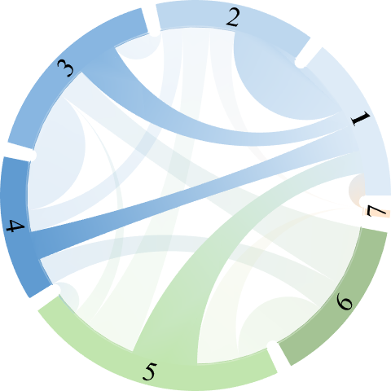
Leave-One-Out
Transferability
Study 1
Study 5
Study 2
Study 6
Study 3
Study 4
Study 7
Notes:
This type of cross-study prediction is under-explored, and it opens up many exciting avenues of research such as:
How similar are the trends in human infection vs human vaccination data.
How similar are the ferret and human responses, and what lessons can we take from ferrets and port into humans?
Which studies have the most transferable information
I’ll point out that comparing these datasets really exemplifies a physicist’s mindset. The literature often makes you feel like every person is special, with their unique infection history and antibody repertoire, and that every study type is distinct and will give its own results.
But this analysis shows that based on these function antibody-virus measurements, there is a lot of predictive power between different people, and even across different study designs.

Slide 5



Combining Large Influenza Datasets
Notes:
There is no reason why we should stop at just gathering datasets for influenza inhibition data. This same framework can be readily generalized to other assays (analyzing binding or neutralization), other viruses, or even to your dataset.
[Pause]
And with that, I would like to thank you for your time, and I will be happy to answer any questions.

